Slide 1
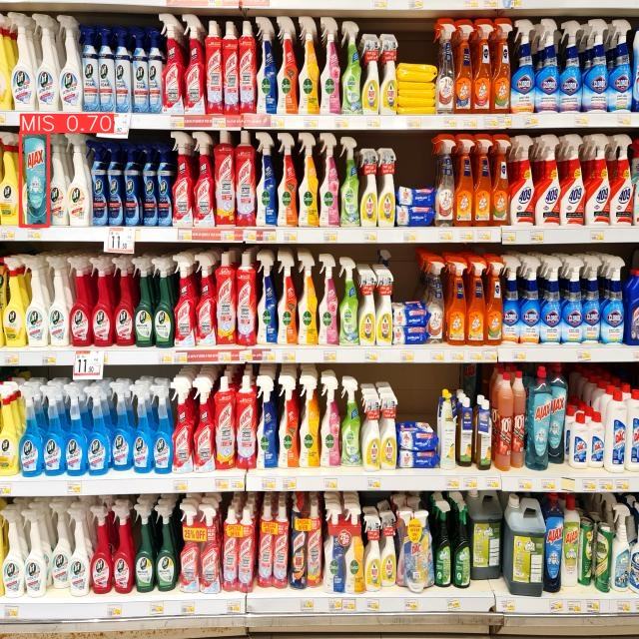

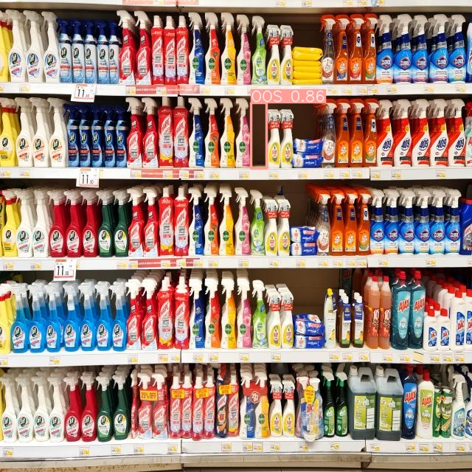
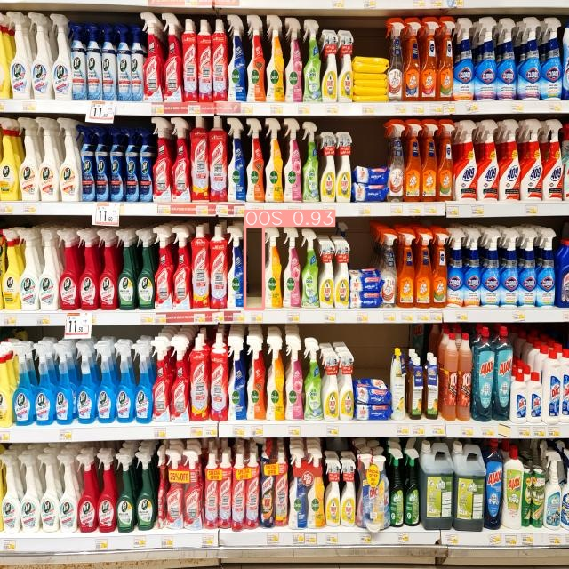
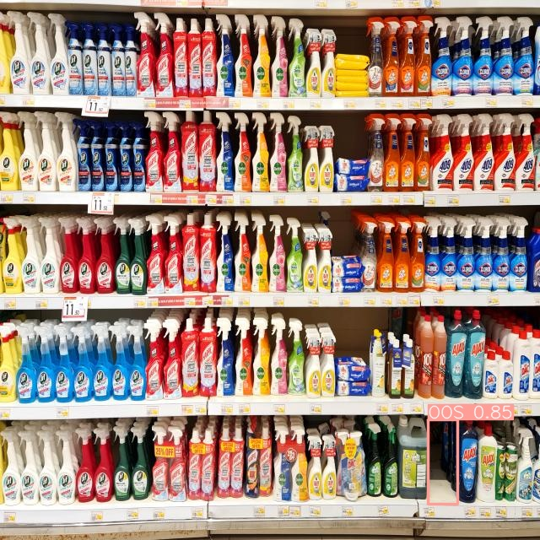
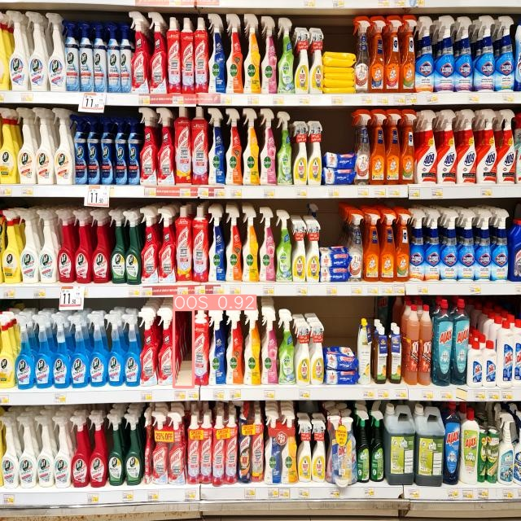
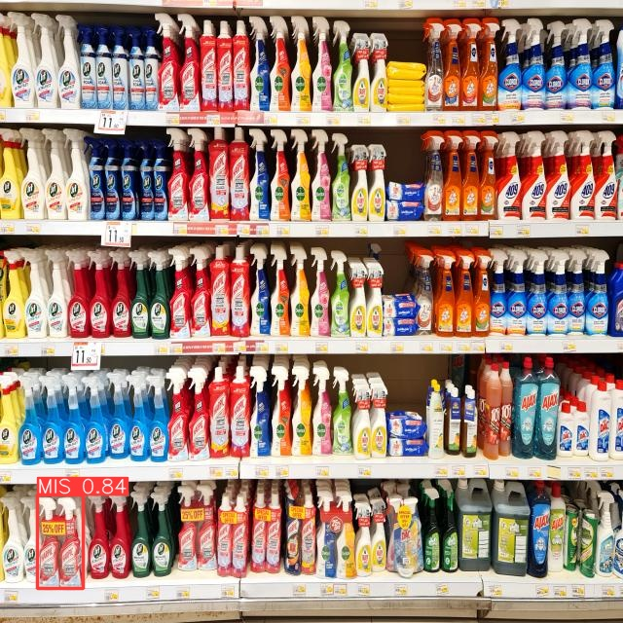
231-ICS-619 Project Video-based Retail Store Shelf Monitoring
Khaled Almutairy
Mamoun Alghaslan

Slide 2
Introduction
Seamless, Saudi Arabia's premier event, highlighted innovations in payments, fintech, retail, e-commerce, home delivery, and digital marketing.
A focus on retails future featured cashier-less stores showcasing AI-powered shelf monitoring, addressing a key industry trend.

Slide 3
Challenges in Retail Inventory Management
Manual Inspection Process: relying on labor-intensive manual work, with employees counting and correcting products on shelves, preparing OOS inventory, retrieving items from storage, and replenishing shelves.
Financial Implications: High expenditure on inventory management and potential customer loss due to frustration or simply not finding the convenience
Limited stock monitoring: Currently, supermarkets rely on distributers to manually count and sort the shelf products and report stock status.

Slide 4
Challenges in current approaches
Limitations of traditional methods (ML, image processing)
Deep learning's need for large annotated datasets
Difficulty in achieving high precision for Out-Of-Stock and Misplaced detection due to shelf layout, object shapes, and occlusion.

Slide 5











Our solution
Notes:
Let’s talk more about our solution.
The basic idea is as follows:
Cameras are installed on
sliding rails in front of
the shelves.
Each camera sees what’s on the opposite shelf unit
The cameras are connected using wifi
To a web server, which hosts
The object detection model.
The application can be used by admins to
manage the database,
As well as the broadcasting service that will
Notify the on-floor employees

Slide 6
Our proposed approach
Collecting images directly from shelves
Labelling products and empty spaces with bounding boxes
Fine-tuning a pre-trained object detection model on a supermarket dataset
Building an efficient system around the detection model

Slide 7
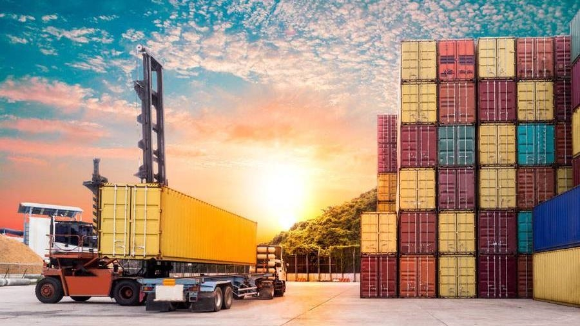
Background & existing solutions

Slide 8
Background
Object Detection and Recognition
Model Implementation Options
Detection involves locating and defining the best bounding box
Recognition refers to classification
Traditional Image Processing such HOG, SIFT, SURF, BRISK and FAST
Deep Learning Networks

Slide 9
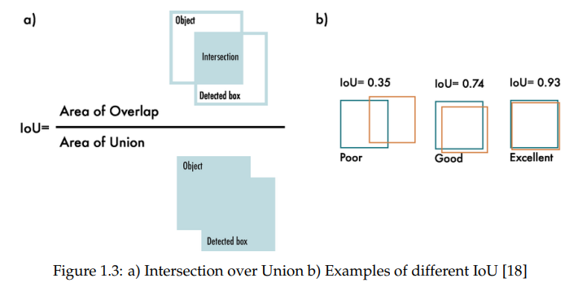
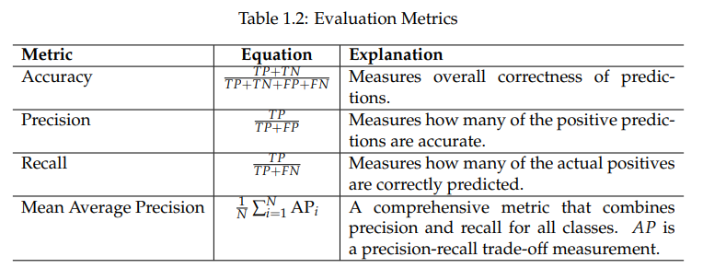
Metrics
Object Detection
Object Recognition

Slide 10
Existing Solutions
Deep Learning methods
Other methods
Faster R-CNN
A two-stage architecture, first generating region proposals and then predicting class labels, and bounding box coordinates
Generally slower due to its two-stage process
YOLO
A single-stage architecture, simultaneously predicting class probabilities and bounding box coordinates in one pass through the network.
Known for its real-time object detection capabilities, achieving faster inference speeds.
Classical Methods
Do not generalize well when applied to new environments.
Depth Estimation Method
Fail to detect product misplacement

Slide 11
Data Collection & Experiments

Slide 12
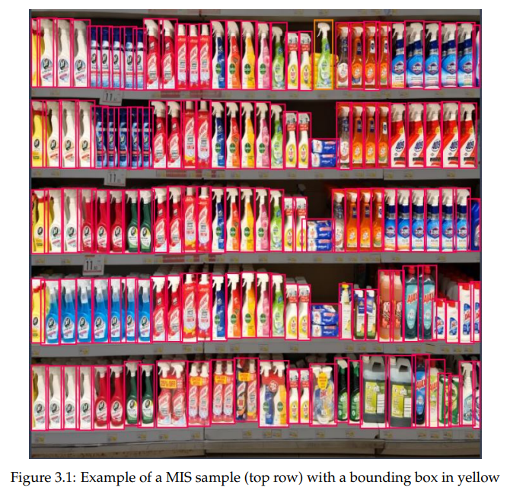
Data Collection
Danube Supermarket
Focused on five shelves ~150 products
Each product was removed to simulate OOS, and 32 product were moved around five times to simulate MIS
A total of 310 images were collected and augmented
Data set was split 90/5/5%, with 15 samples of OOS and MIS in val./test
Roboflow for annotation

Slide 13
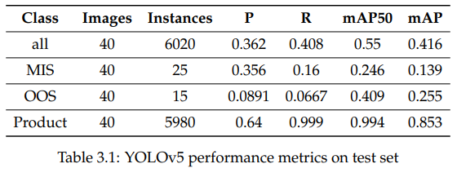
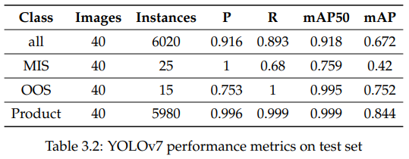
Experiments
YOLOv5
YOLOv7
Paperspace Jupyter Notebook, Quadro-P6000 GPU, 5- and 2.5-hours training time respectively

Slide 14
System Design

Slide 15
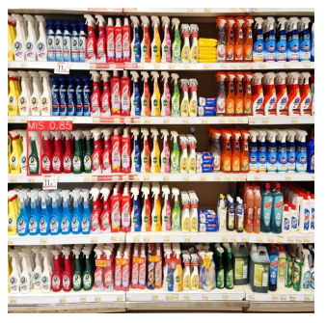
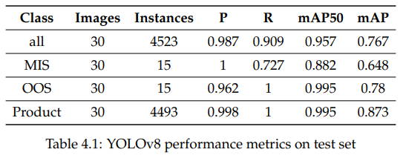
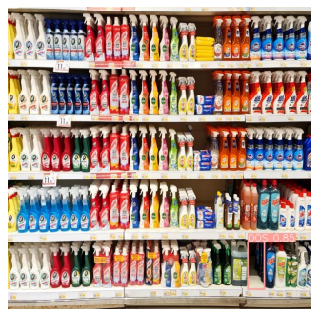
Model fine-tuning
YOLOv8s
Results

Slide 16
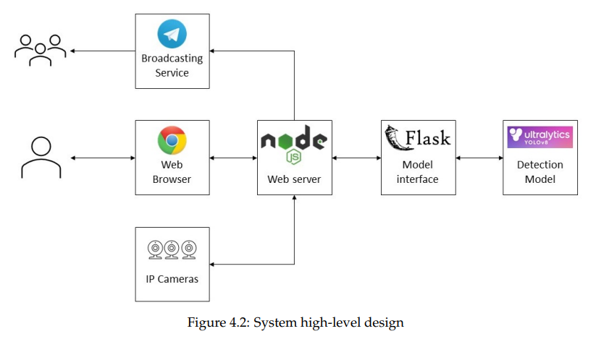
System Design
Components
Diagram
Detection model
Model API
Web Server
Web-site server
Web worker
Broadcasting service
IP Cameras

Slide 17
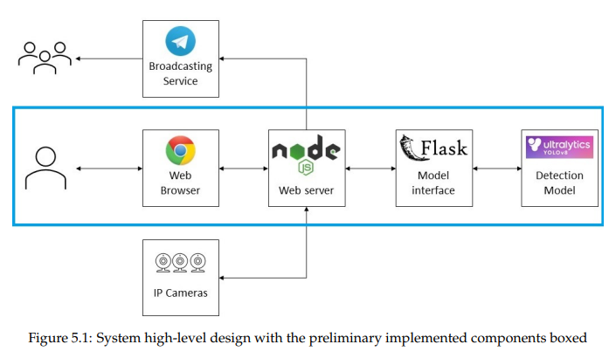
Prototype
Design
Implemented Components
Web server: Node.js + Express
Model server: Python + Flask

Slide 18
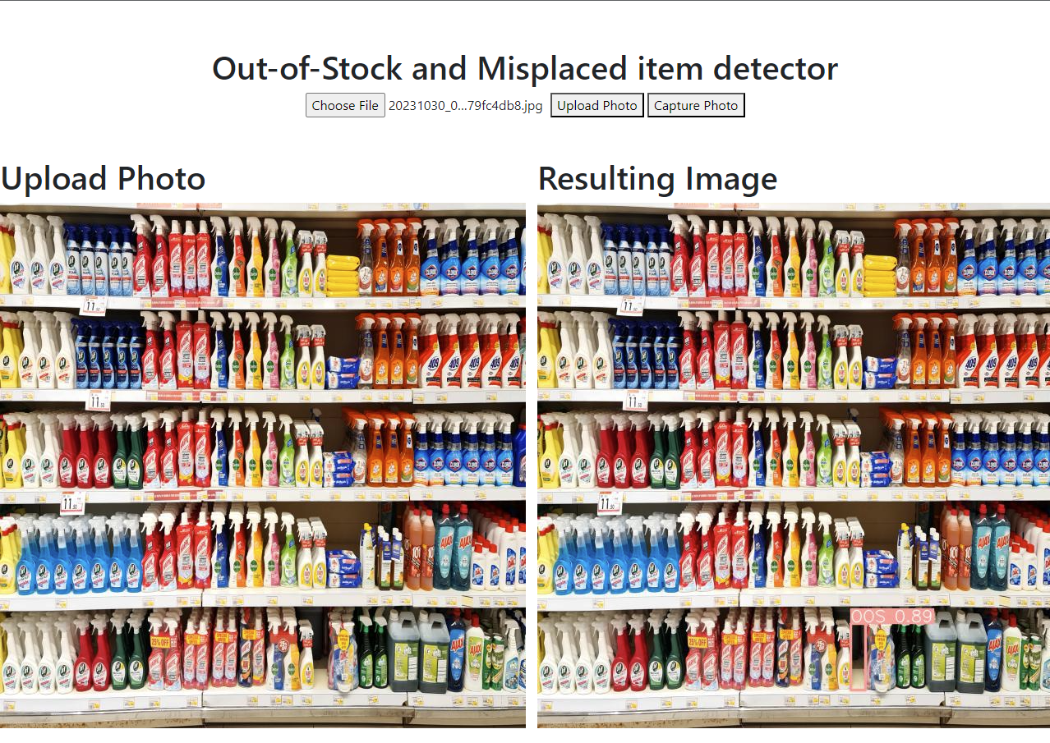
Prototype

Slide 19
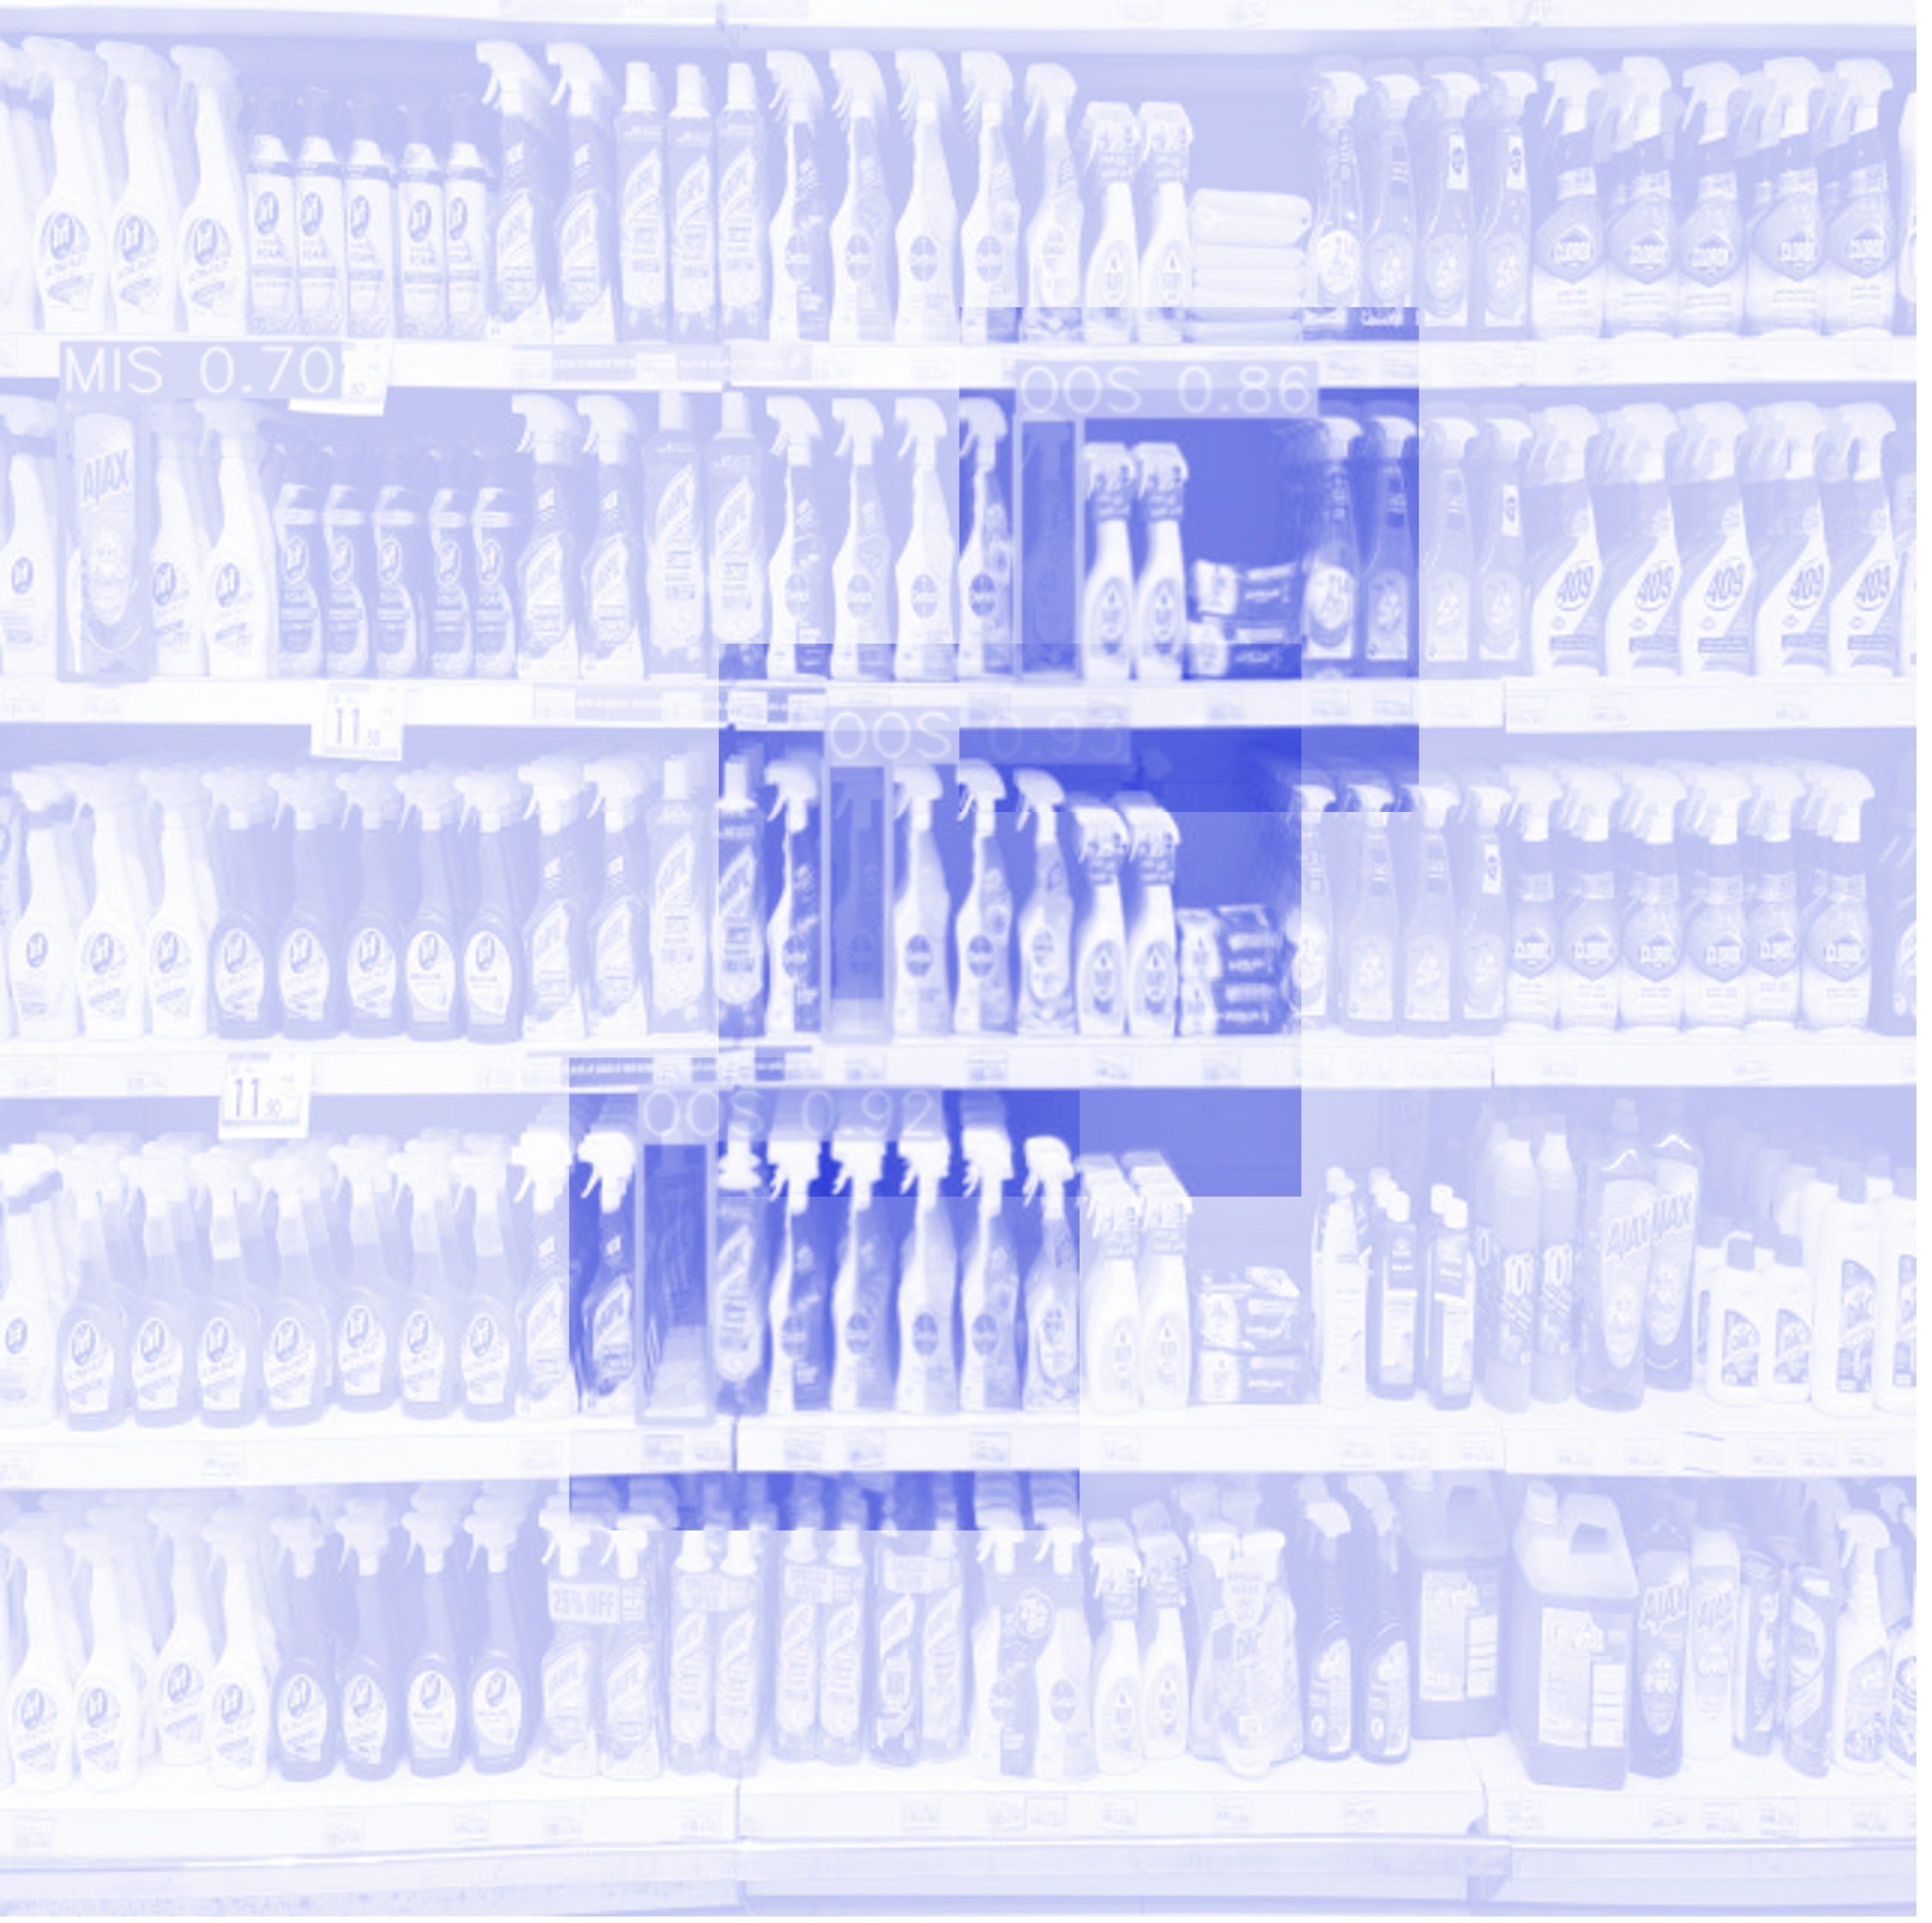
Conclusion
Developed a Video-based Retail Store Shelf Monitoring System (SMS) using deep learning.
Created dataset from Danube supermarket for Out-Of-Stock (OOS) and product misplacement (MIS).
Achieved mean Average Precision (mAP) scores of 0.882 for MIS and 0.995 for OOS.
Developed a preliminary prototype as a proof-of-concept for feasibility.
Future work includes real-world testing, refining accuracy, scalability, exploring additional functionalities like shelf restocking

Slide 20
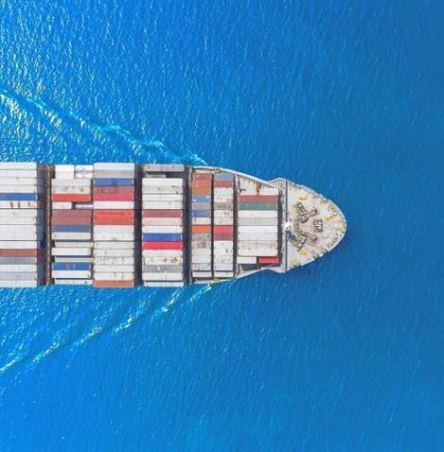
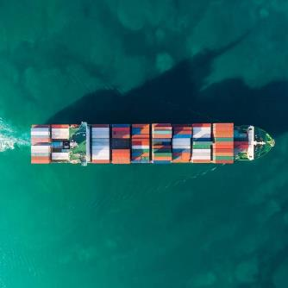
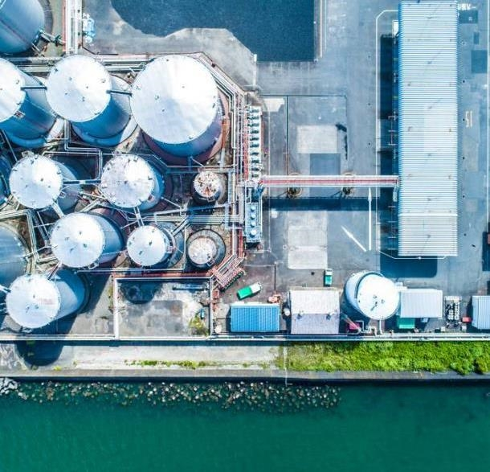
THANK YOU
Mamoun Alghaslan, Khaled Almutairy

